Slide 1



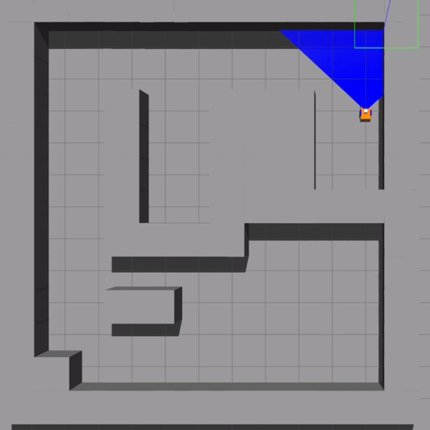
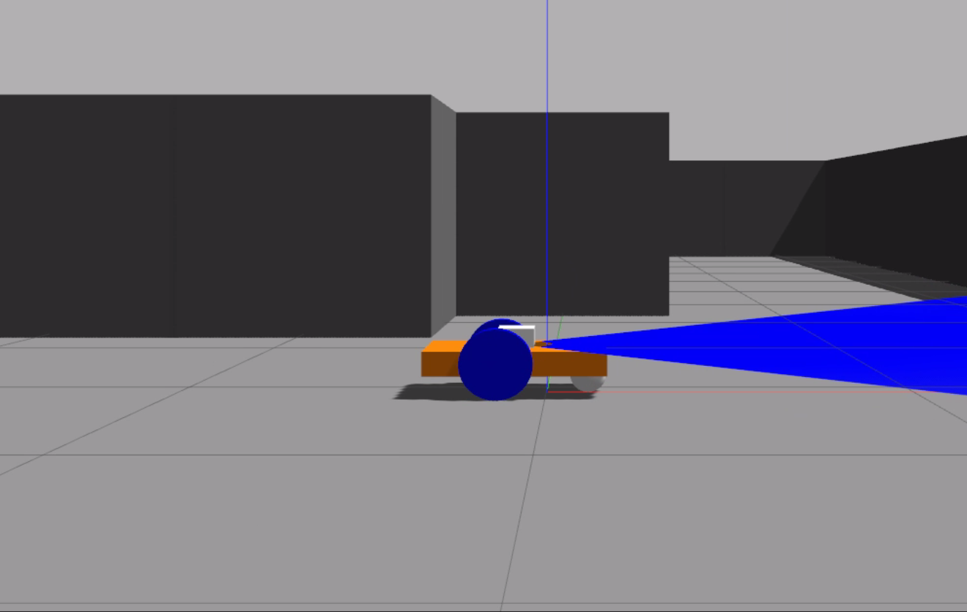
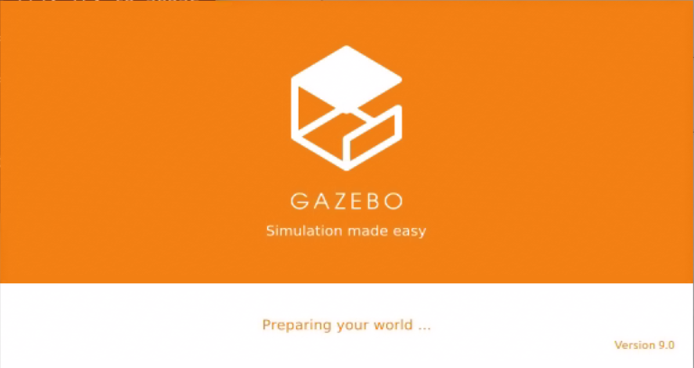
Navigation and obstacle evasion algorithm Gazebo simulation
Raeed Mundow and Wiaam Fares, Supervised by Igal Alterman
Introduction
ROS
The map
Robot technology is advancing at an astonishing pace.
The need for robots to autonomously drive.
Self moving robots need to detect and avoid obstacles and navigate between two points.
Gazebo is an excellent tool to simulate robot behavior and movements.
Stands for: robot operating system.
Set of software framework to operate a robot.
Works really well with Gazebo.
Known map navigation
First step is to simulate a robot navigating a map that he knows.
Known map means known obstacle location so we don’t have to deal with them.
Use A star algorithm.
Use Manhattan heuristic.
Environment variables
Laser width and depth.
Laser measurements std.
Algorithm heuristic.
Starting and Ending point
Changing any of these can have a huge impact on the execution time and on the efficiency of the algorithm.
Unknown map navigation
Goals
First develop a way to detect obstacles and a road.
Use laser scanner.
Modify A star algorithm to work in real time.
The algorithm goes as follows:
Scan
Detect obstacles
Detect available road
Update Global map
Move to a new point using A star
Repeat the process till the end
Develop an algorithm for navigating an unknown map and evade obstacles along the way
Build a Gazebo robot simulation to test the algorithm
Test the simulation under different variable changes
Result
Challenges
Robot reaches the end.
Robot can detect obstacles and avoid them.
Robot can detect dead ends and avoid them.
Detecting obstacles method works for laser std less than 0.05
No prior knowledge on Gazebo or ROS.
Very complicated environment.
A star algorithm doesn’t work in an unknown map.
Detecting obstacles.
There is no perfect algorithm for the job.
Results
Hokuyo laser scanner
Conclusions
Use Gazebo built in plugin Hokuyo laser to detect obstacles.
Laser is comprised of many rays.
If a ray hits an obstacle, it returns the distance the ray traveled.
A star algorithm works great for predetermined environment.
A star can be modified in multiple ways to work in an unknown environment.
Different maps can have different execution times. Heuristic efficiency heavily depends on the map.
Gazebo
ROS Topics
ROS software system is built on something called topics.
Each topic can be used to communicate with the robot.
You can either subscribe (take info) to the topic, or publish (send info) to the topic.
We used the following topics:
Twist movement
Scan
Geometry
Gazebo is a simulation environment for robots.
Includes real life like variables such as wind, slope…etc.
Still relatively new.
Works with ROS, we can control the robot with software
Has a physics engine, we can configure the physics of the simulation.
September 2022

